Slide 1

Class 4 – Polynomial Regression and Resampling methods
Pedram Jahangiry
Fall 2019

Slide 2
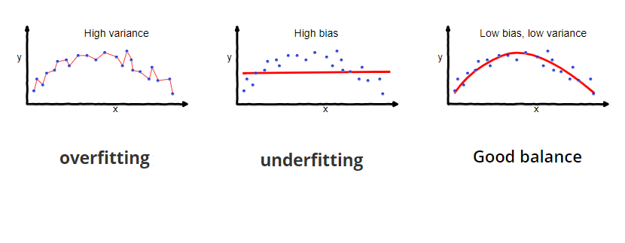
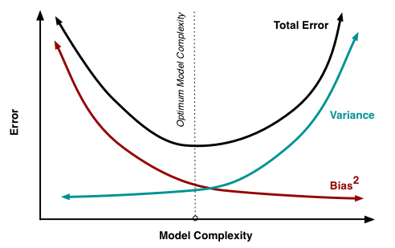
Notes:
Very low variance vs Extremely low bias

Slide 3
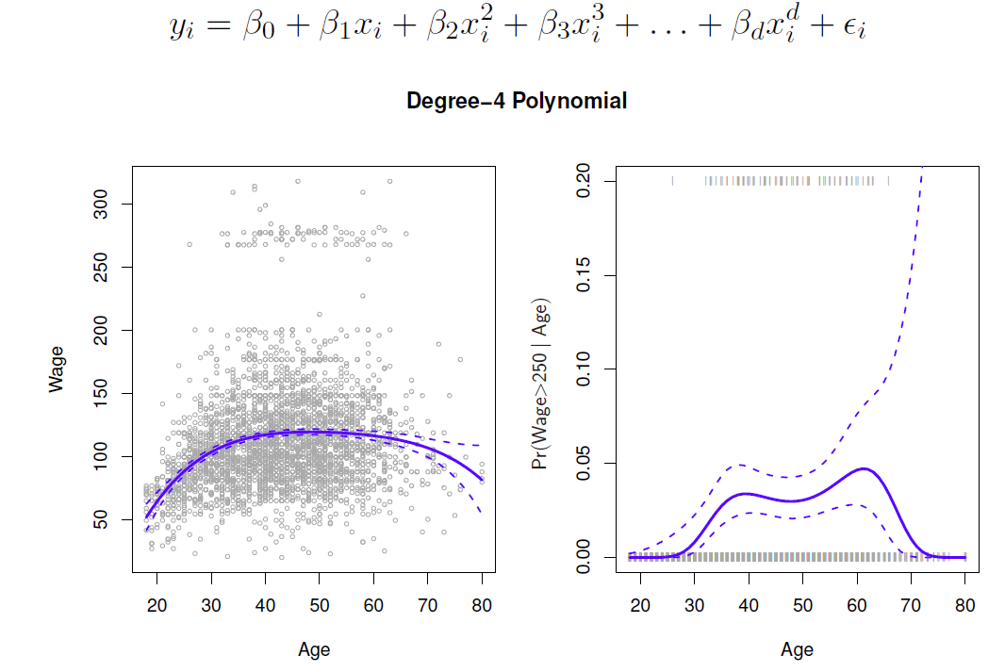
Polynomial Regression

Slide 4
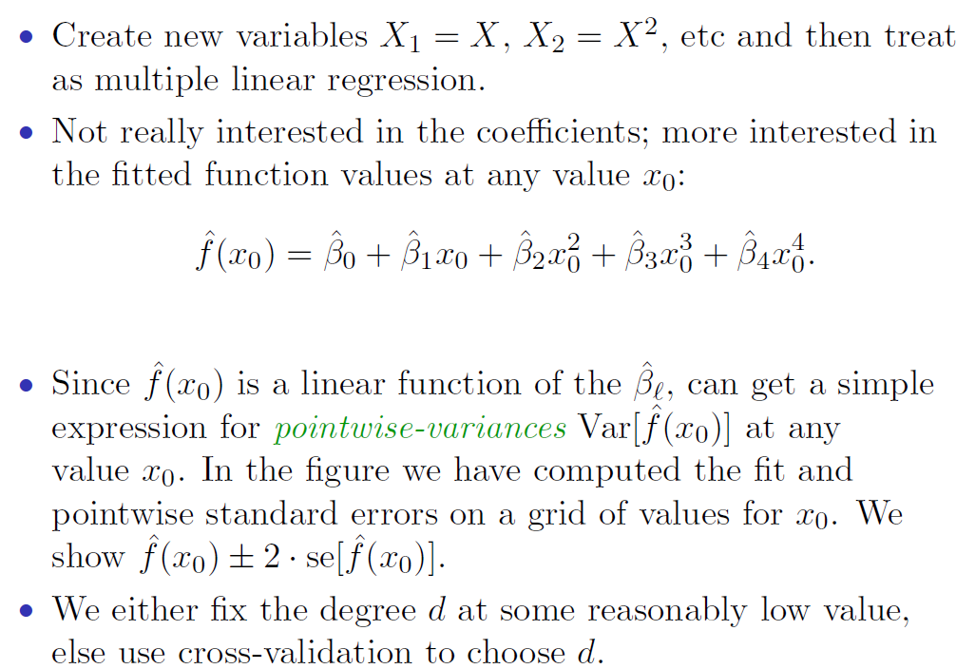
Polynomial Regression

Slide 5
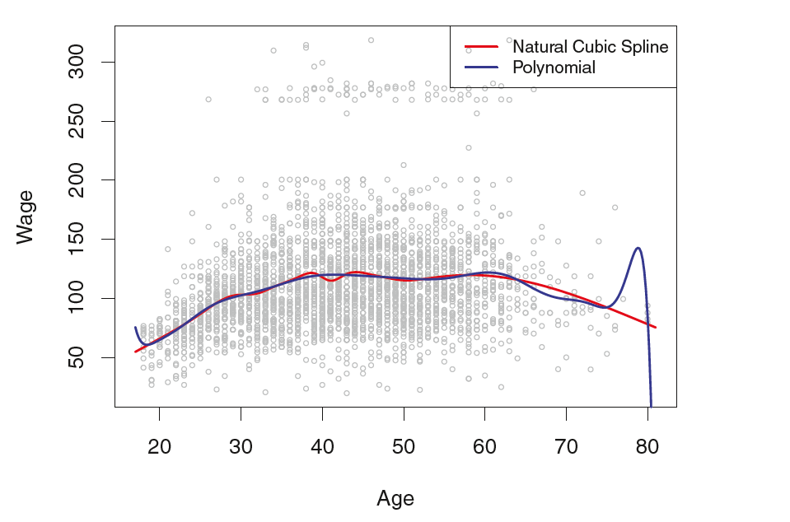
Polynomial Regression (Caveat!)
Polynomials have notorious tail behavior – Very bad for extrapolation.
Polynomials are global fit! Solution: Piecewise polynomial, splines and local regressions.
Notes:
Comparison of a degree-14 polynomial and a natural cubic spline, each with 15df.
Splines are much better behaved and more local.

Slide 6
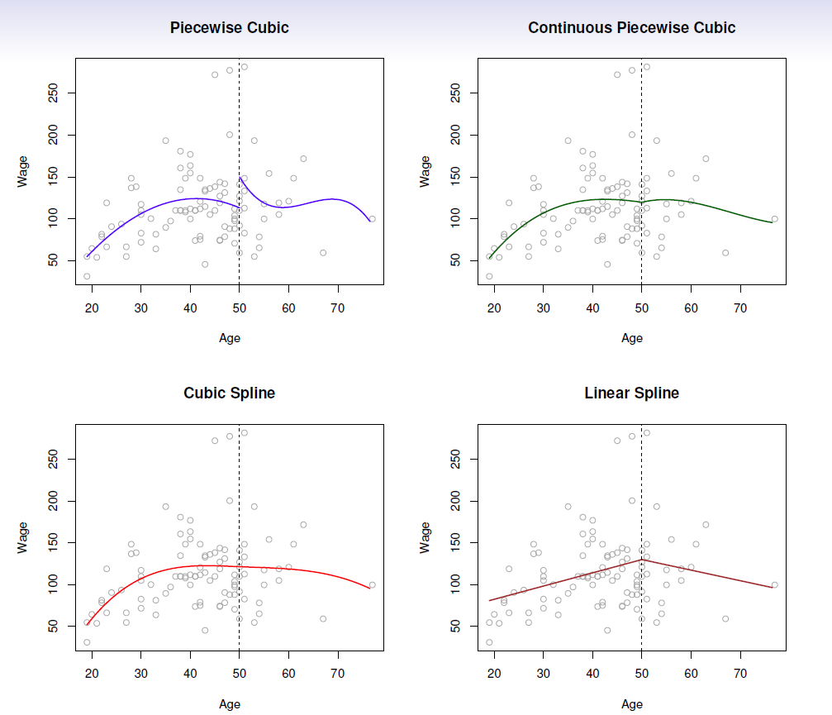
Notes:
Splines with 1 knots in this example.
Linear spline: continuous at each knot
Cubic spline: continuous at each knot + continuous at first and second derivative.
This is what we used backed at BlackRock. (interpretable and practical)
A natural cubic spline extrapolates linearly beyond the boundary knots. This adds 4 = 2 2 extra constraints, and allows us to put more internal knots for the same degrees of freedom as a regular cubic spline.

Slide 7
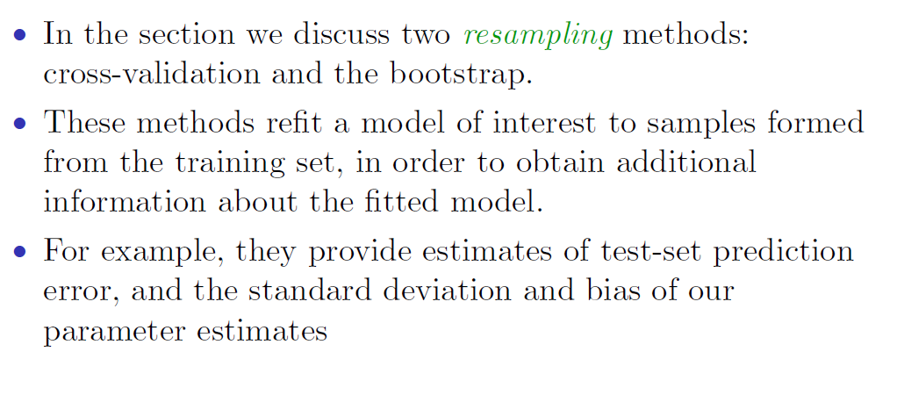
Resampling methods
Notes:
CV is a better than bootstrap because there is no overlap between validation set and the training set. In bootstrap 2/3 of the data is observed before and therefor it is underestimated the test errors. Bootstrap is good for estimating the parameters and the se(betas) though. But this is not something that we are interested in machine learning.

Slide 8
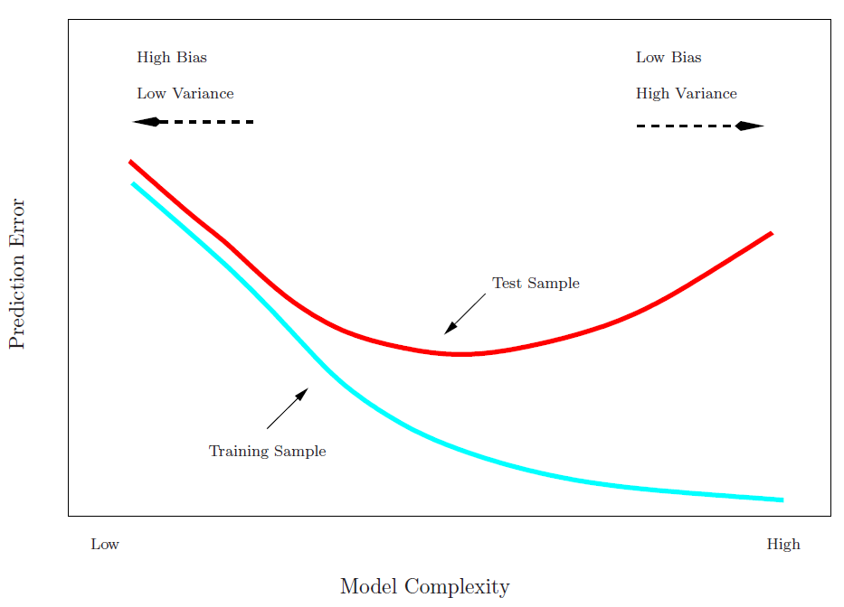
Training vs Test set performance

Slide 9
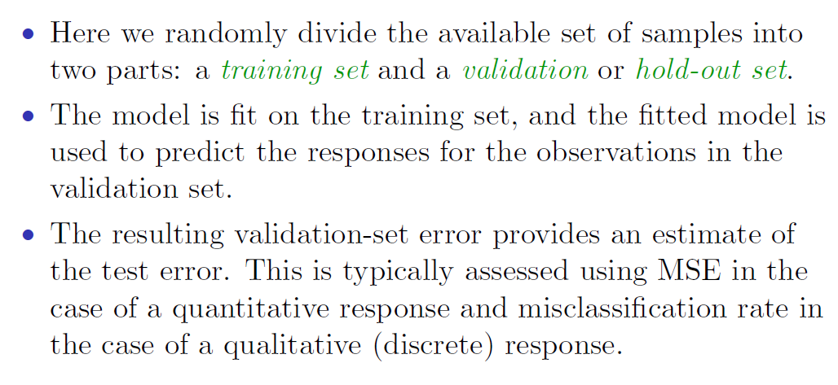
Validation Set Approach
Notes:
We do cross validation techniques to:
1- get an idea about our test errors
2- how complex the model needs to be by choosing the right feature (ex: polynomial order)

Slide 10
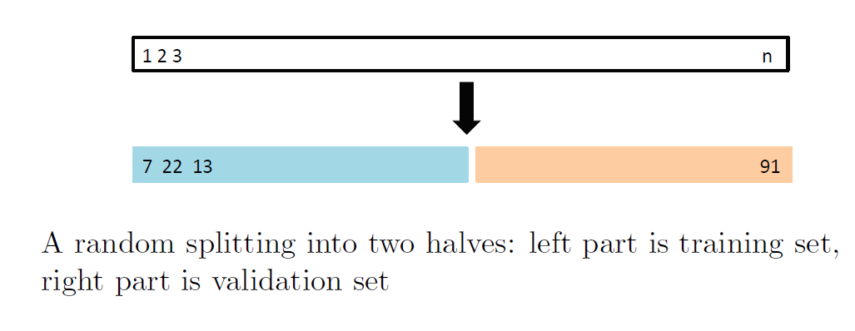
The validation process

Slide 11
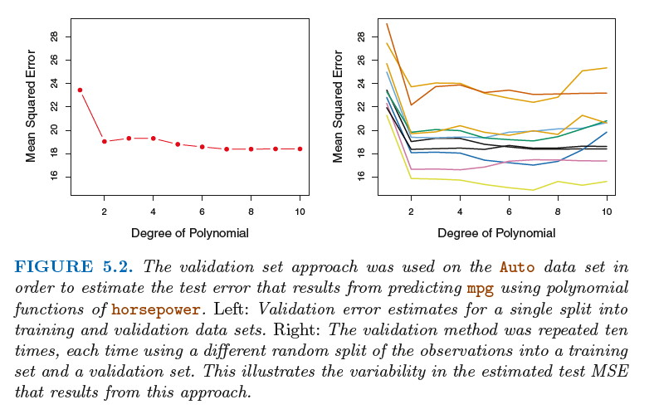
Example
Notes:
The validation set approach was used on the Auto data set in order to estimate the test error that results from predicting mpg using polynomial functions of horsepower.

Slide 12
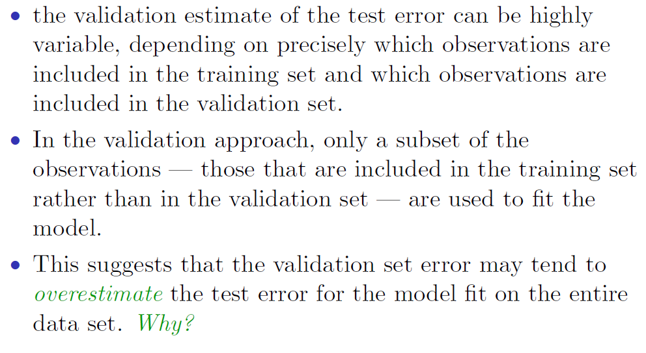
Drawbacks of validation set approach
Notes:
Since statistical methods tend to perform worse when trained on fewer observations, this suggests that the validation set error rate may tend to overestimate the test error rate for the model fit on the entire data set.

Slide 13
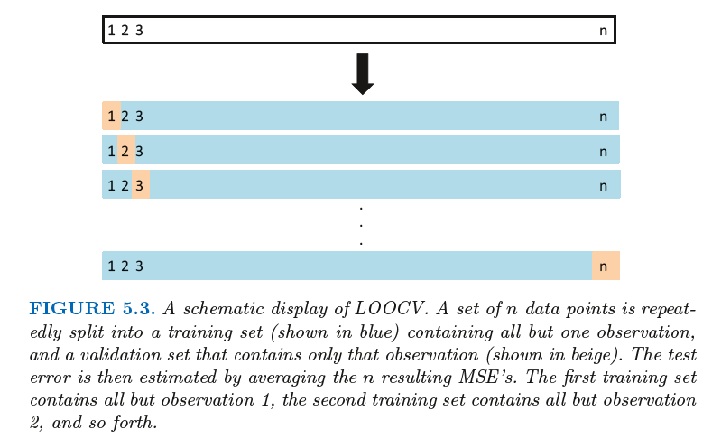
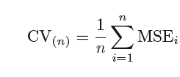
Leave-One-Out Cross-Validation (LOOCV)

Slide 14
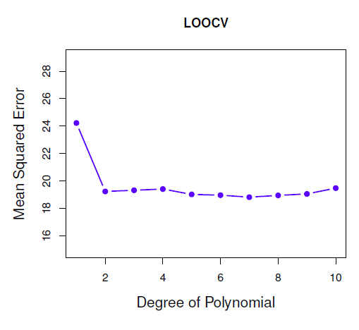
LOOCV advantages and disadvantages
Very small bias:
contain (n − 1) observations, almost as many as are in the entire data set
Always yield the same results:
there is no randomness in the training/validation set splits.
Expensive to implement
High variance!
Notes:
Therefore, from the perspective of bias reduction, it is clear that LOOCV is to be preferred to k-fold CV. However, we know that bias is not the only source for concern in an estimating procedure; we must also consider the procedure’s variance. It turns out that LOOCV has higher variance than does k-fold CV with k < n. Why is this the case? When we perform LOOCV, we are in effect averaging the outputs of n fitted models, each of which is trained on an almost identical set of observations; therefore, these outputs are highly (positively) correlated with each other. In contrast, when we perform k-fold CV with k < n, we are averaging the outputs of k fitted models that are somewhat less correlated with each other, since the overlap between the training sets in each model is smaller. Since the mean of many highly correlated quantities has higher variance than does the mean of many quantities that are not
as highly correlated, the test error estimate resulting from LOOCV tends to have higher variance than does the test error estimate resulting from k-fold CV. To summarize, there is a bias-variance trade-off associated with the choice of k in k-fold cross-validation. Typically, given these considerations, one performs k-fold cross-validation using k = 5 or k = 10, as these values have been shown empirically to yield test error rate estimates that suffer neither from excessively high bias nor from very high variance.

Slide 15
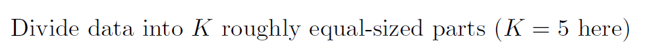
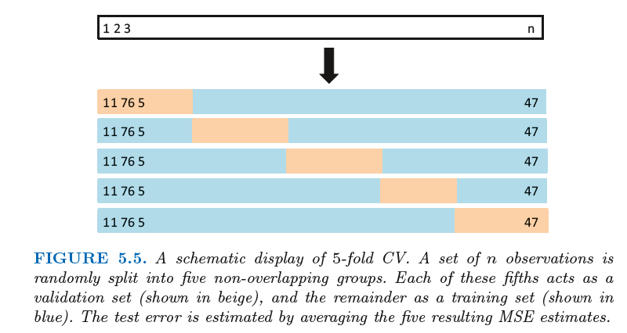

K-fold Cross-Validation

Slide 16
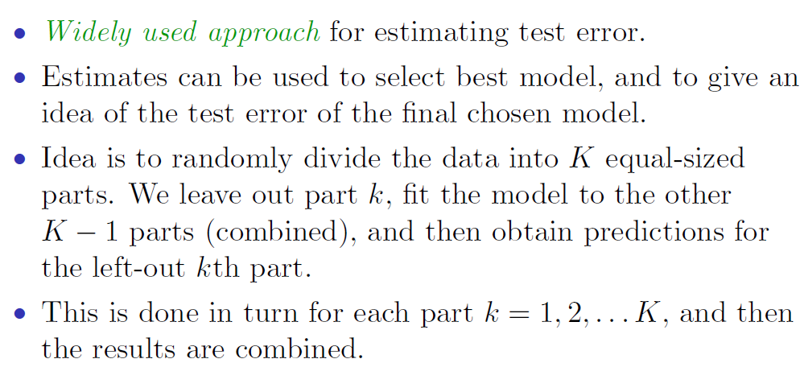
K-fold Cross-Validation

Slide 17
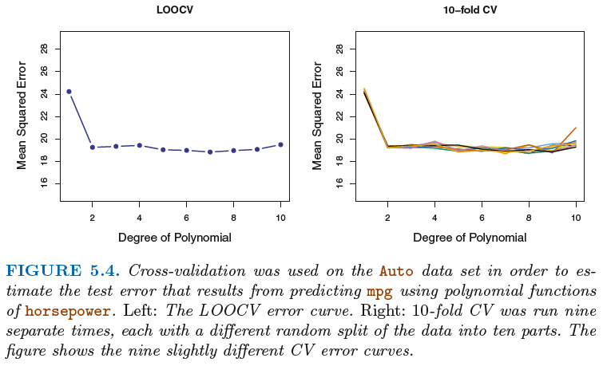
K-fold Cross-validation vs LOOCV
Notes:
putting computational issues aside, a less obvious but potentially more important advantage of k-fold CV is that it often gives more accurate estimates of the test error rate than does LOOCV. This has to do with a bias-variance trade-off.

